Slide 1
Chapter 3: RATIO AND PROPORTION
1. Number system
2. H.C.F and L.C.M
3. Averages
4. Percentages
5. Ratio and Proportion
6. Problems on Ages
7. Partnership
8. Allegation and Mixture

Slide 2
Ratio and Proportion
Ratio
A ratio is a comparison of two quantities by division. It is a relation that one quantity bears to another with respect to magnitude. In other words, ratio means what part one quantity is of another. The quantities may be of same kind or different kinds.
If a and b are two numbers, the ratio of a to b is (a/b) or a ÷ b and is denoted by a:b. The two quantities that are being compared are called terms.
The first is called antecedent and the second term is called consequent.
For example, the ratio 3:5 represents (3/5)
with antecedent 3 and consequent 5.

Slide 3
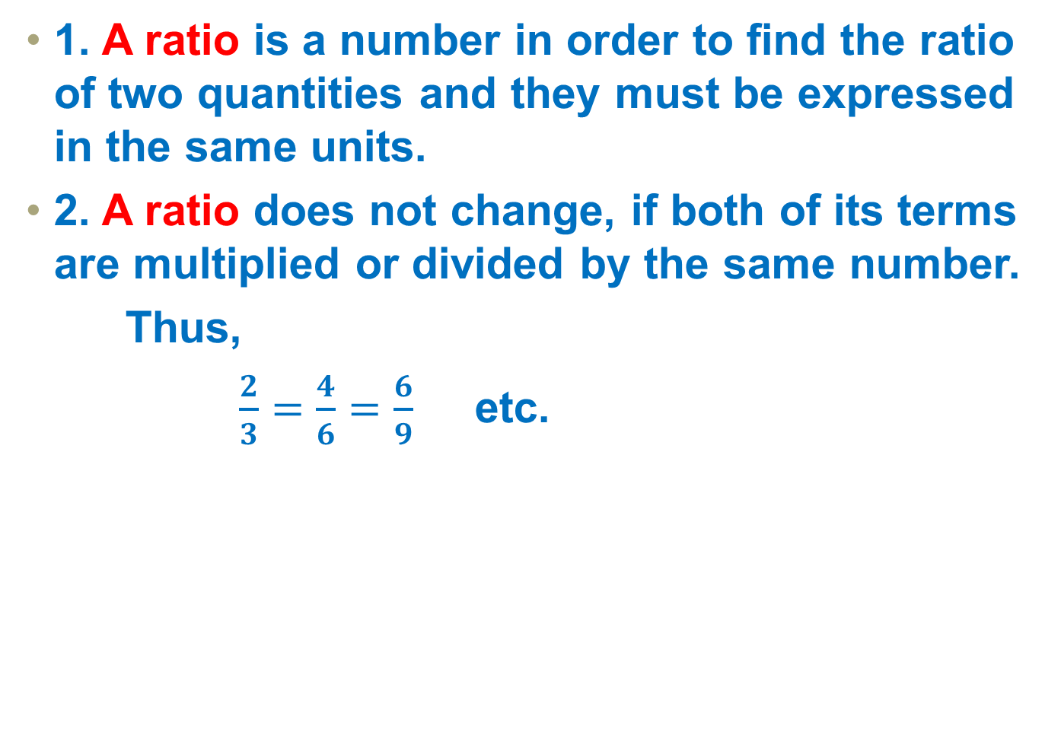
Ratio - Notes
1. A ratio is a number in order to find the ratio of two quantities and they must be expressed in the same units.
2. A ratio does not change, if both of its terms are multiplied or divided by the same number.
Thus,
$\frac{2}{3}=\frac{4}{6}=\frac{6}{9}$ etc.

Slide 4
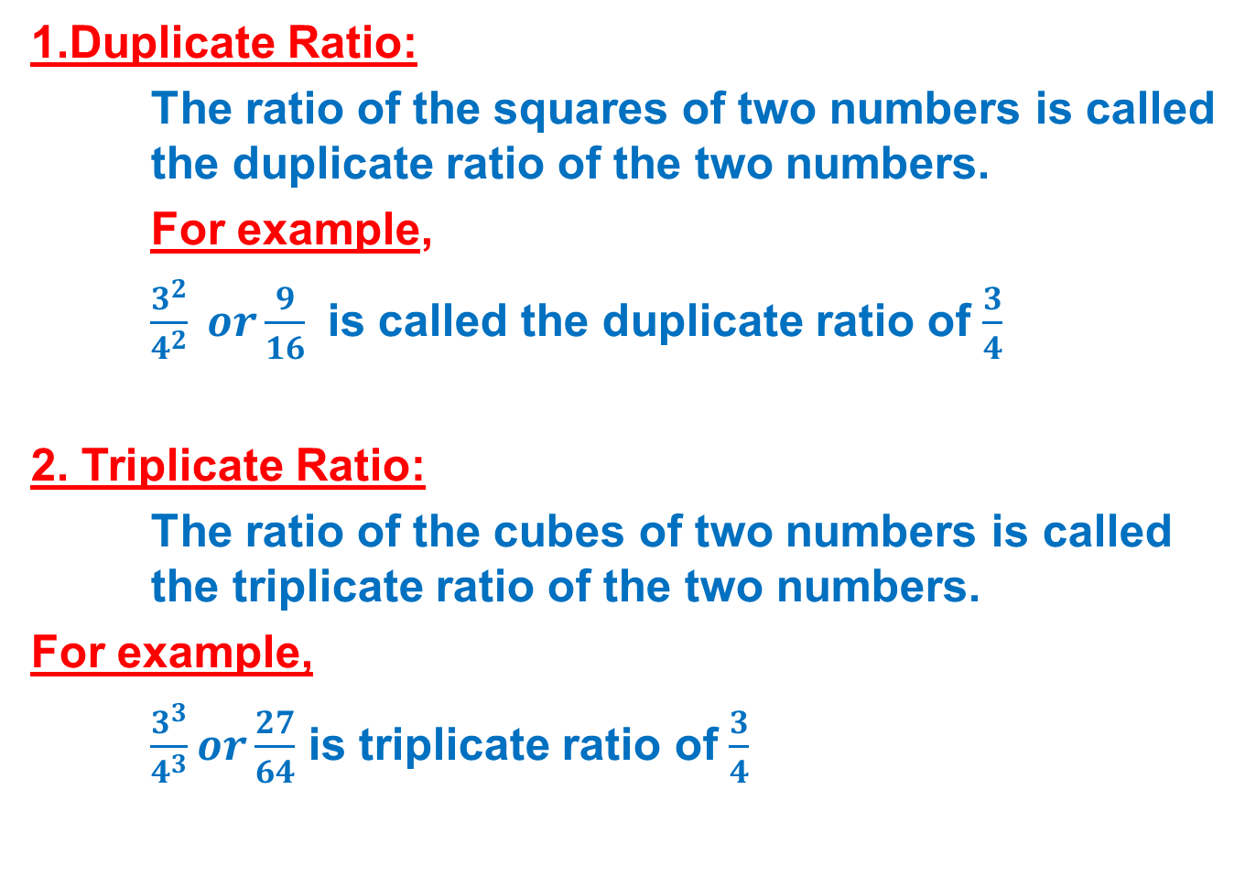
Types of Ratios
1.Duplicate Ratio:
The ratio of the squares of two numbers is called the duplicate ratio of the two numbers.
For example,
$\frac{3^{2}}{4^{2}} or\frac{9}{16}$ is called the duplicate ratio of $\frac{3}{4}$
2. Triplicate Ratio:
The ratio of the cubes of two numbers is called the triplicate ratio of the two numbers.
For example,
$\frac{3^{3}}{4^{3}}or\frac{27}{64}$ is triplicate ratio of $\frac{3}{4}$

Slide 5
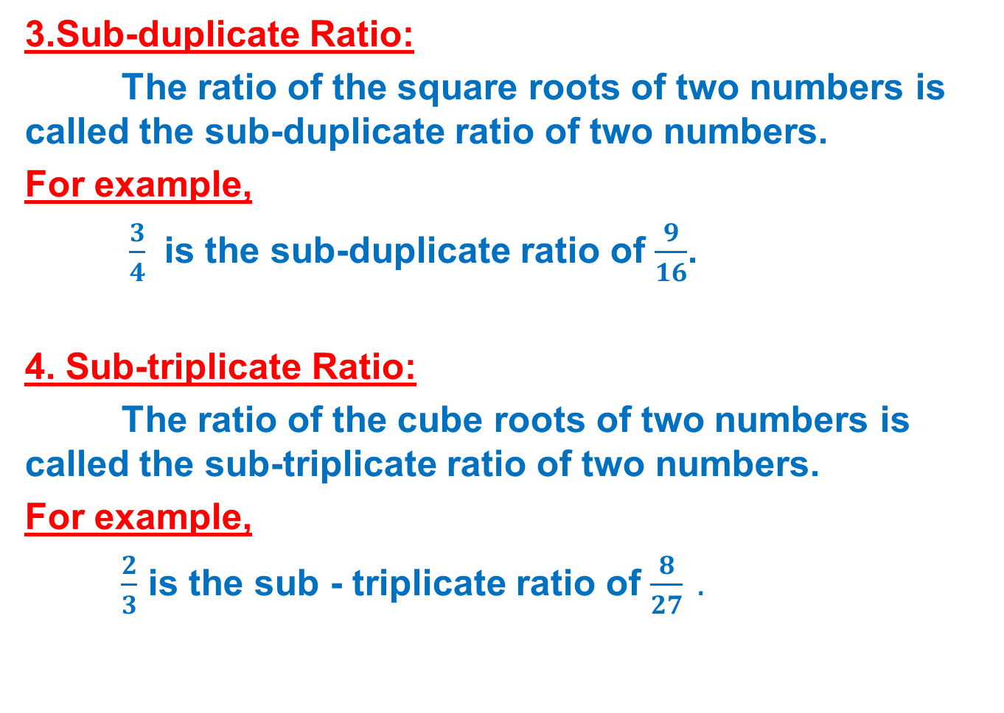
Types of Ratios
3.Sub-duplicate Ratio:
The ratio of the square roots of two numbers is called the sub-duplicate ratio of two numbers.
For example,
$\frac{3}{4}$ is the sub-duplicate ratio of $\frac{9}{16}$.
4. Sub-triplicate Ratio:
The ratio of the cube roots of two numbers is called the sub-triplicate ratio of two numbers.
For example,
$\frac{2}{3}$ is the sub - triplicate ratio of $\frac{8}{27} .$

Slide 6
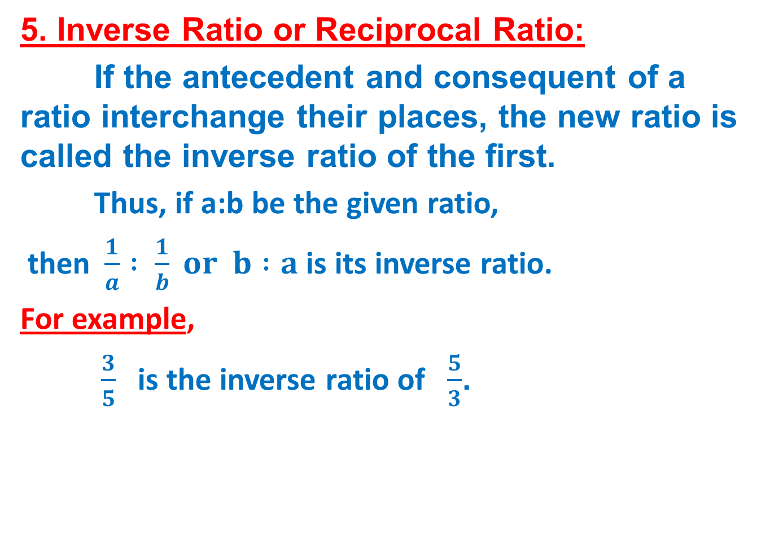
Types of Ratios
5. Inverse Ratio or Reciprocal Ratio:
If the antecedent and consequent of a ratio interchange their places, the new ratio is called the inverse ratio of the first.
Thus, if a:b be the given ratio,
then$\frac{1}{a} : \frac{1}{b} or$ $b :a$ is its inverse ratio.
For example,
$\frac{3}{5}$is the inverse ratio of $\frac{5}{3}$.

Slide 7
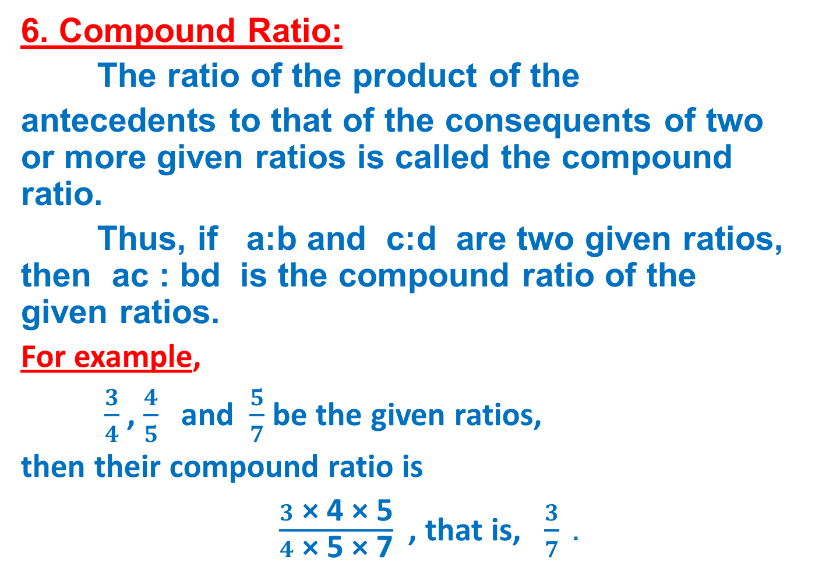
Types of Ratios
6. Compound Ratio:
The ratio of the product of the
antecedents to that of the consequents of two or more given ratios is called the compound ratio.
Thus, if a:b and c:d are two given ratios, then ac : bd is the compound ratio of the given ratios.
For example,
$\frac{3}{4}$, $\frac{4}{5}$ and $\frac{5}{7}$ be the given ratios,
then their compound ratio is
$\frac{3 \text{×}\text{ 4 }\text{×}\text{ 5}}{4 \text{×}\text{ 5 }\text{×}\text{ 7}}$, that is, $\frac{3}{7} .$

Slide 8
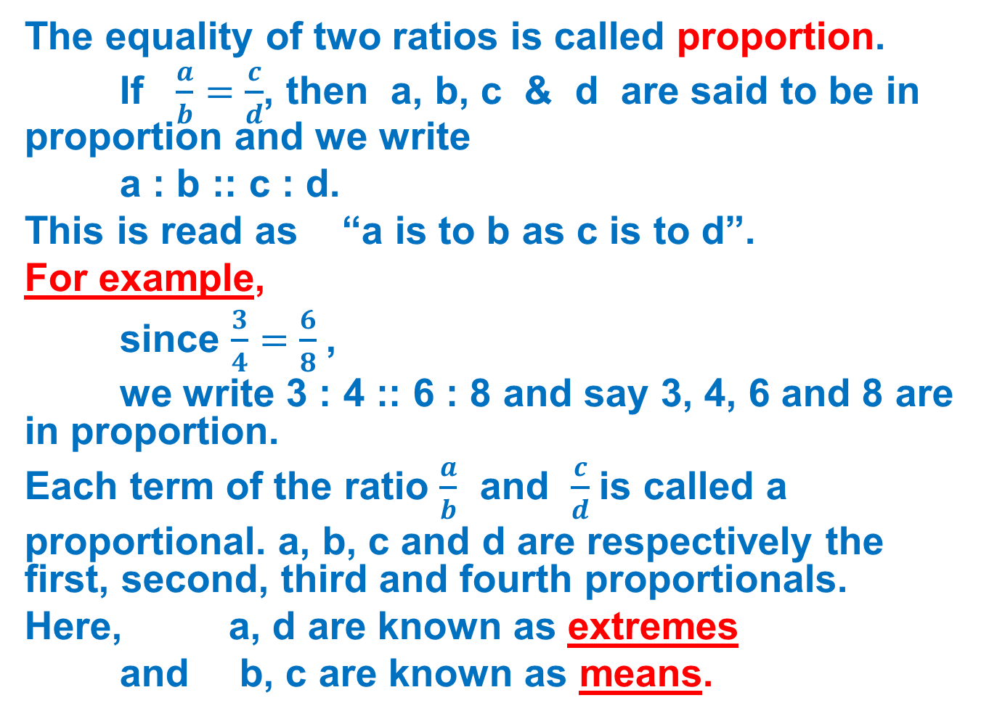
Proportion
The equality of two ratios is called proportion.
If $\frac{a}{b}=\frac{c}{d}$, then a, b, c & d are said to be in proportion and we write
a : b :: c : d.
This is read as “a is to b as c is to d”.
For example,
since $\frac{3}{4}=\frac{6}{8}$,
we write 3 : 4 :: 6 : 8 and say 3, 4, 6 and 8 are in proportion.
Each term of the ratio $\frac{a}{b}$ and $\frac{c}{d}$is called a
proportional. a, b, c and d are respectively the first, second, third and fourth proportionals.
Here, a, d are known as extremes
and b, c are known as means.

Slide 9
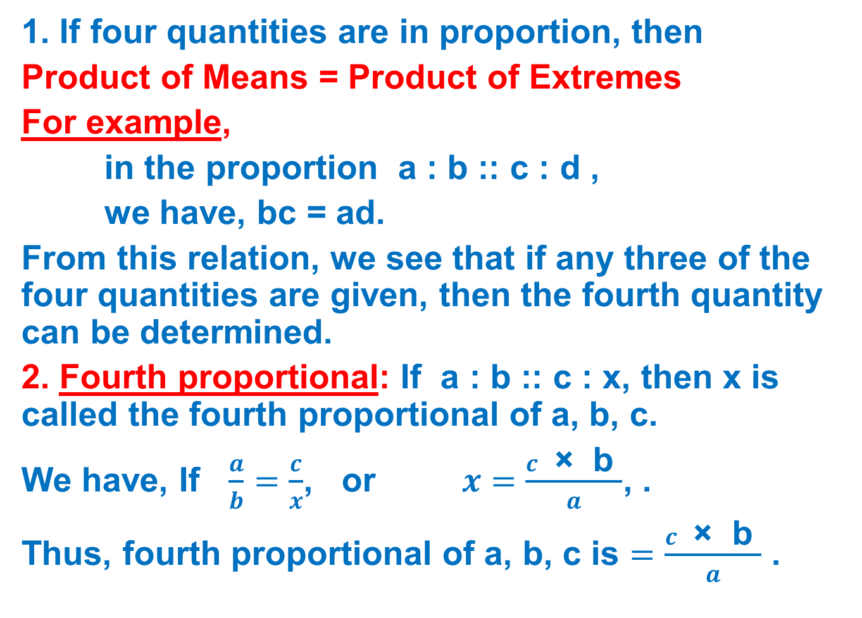
Basic Formulae
1. If four quantities are in proportion, then
Product of Means = Product of Extremes
For example,
in the proportion a : b :: c : d ,
we have, bc = ad.
From this relation, we see that if any three of the four quantities are given, then the fourth quantity can be determined.
2. Fourth proportional: If a : b :: c : x, then x is called the fourth proportional of a, b, c.
We have, If $\frac{a}{b}=\frac{c}{x}$, or $x=\frac{c \text{×} \text{b} }{a}$, .
Thus, fourth proportional of a, b, c is $=\frac{c \text{×} \text{b} }{a}$ .

Slide 10
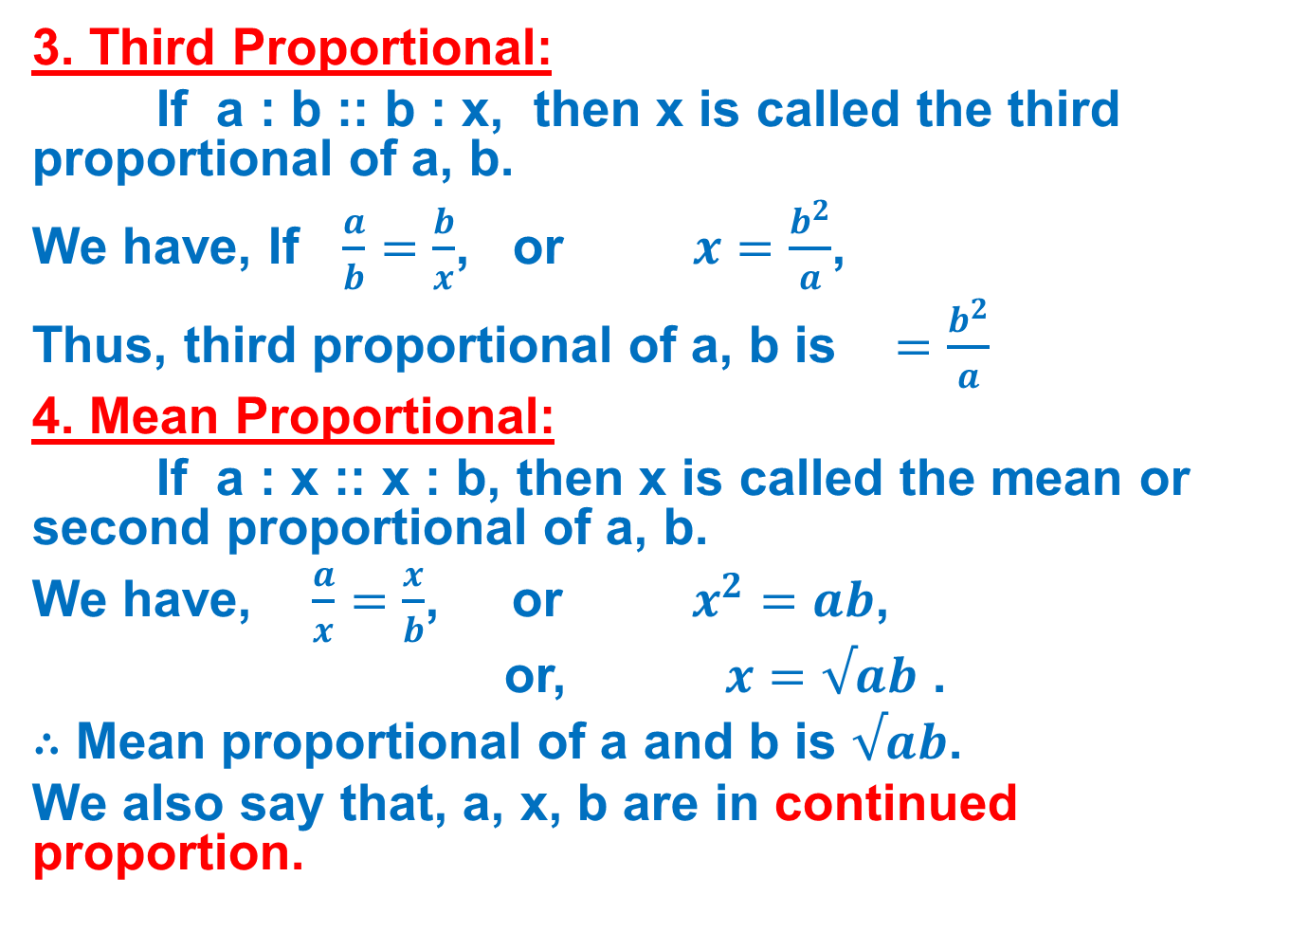
Basic Formulae
3. Third Proportional:
If a : b :: b : x, then x is called the third proportional of a, b.
We have, If $\frac{a}{b}=\frac{b}{x}$, or $x=\frac{b^{2}}{a}$,
Thus, third proportional of a, b is $=\frac{b^{2}}{a}$
4. Mean Proportional:
If a : x :: x : b, then x is called the mean or second proportional of a, b.
We have, $\frac{a}{x}=\frac{x}{b}$, or $x^{2}=ab$,
or, $x=√ab$ .
∴ Mean proportional of a and b is $√ab$.
We also say that, a, x, b are in continued proportion.

Slide 11

Basic Formulae
If $\frac{a}{b}=\frac{c}{d}$, then
(i) $\frac{a+b}{b}=\frac{c+d}{d}$, (Componendo)
(ii) $\frac{a−b}{b}=\frac{c−d}{d},$(Dividendo)
(iii) $\frac{a+b}{a−b}=\frac{c+d}{c−d}$ (Componendo and Dividendo)

Slide 12
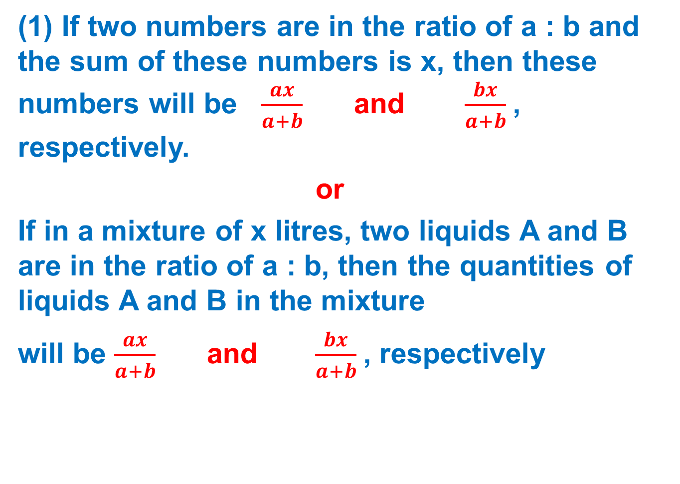
short-cut methods
(1) If two numbers are in the ratio of a : b and the sum of these numbers is x, then these numbers will be $\frac{ax}{a+b}$and $\frac{bx}{a+b}$, respectively.
or
If in a mixture of x litres, two liquids A and B are in the ratio of a : b, then the quantities of liquids A and B in the mixture
will be $\frac{ax}{a+b}$and $\frac{bx}{a+b}$, respectively

Slide 13
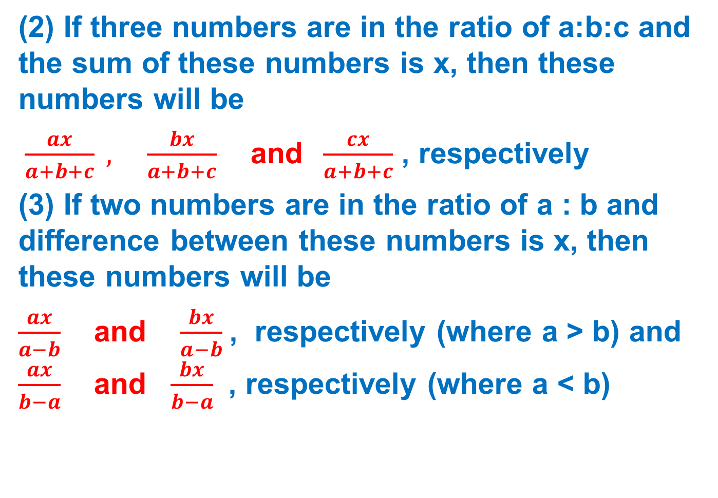
short-cut methods
(2) If three numbers are in the ratio of a:b:c and the sum of these numbers is x, then these numbers will be
$\frac{ax}{a+b+c} , \frac{bx}{a+b+c}$ and $\frac{cx}{a+b+c}$ , respectively
(3) If two numbers are in the ratio of a : b and difference between these numbers is x, then these numbers will be
$\frac{ax}{a−b}$and $\frac{bx}{a−b}$, respectively (where a > b) and $\frac{ax}{b−a}$and $\frac{bx}{b−a}$ , respectively (where a < b)

Slide 14
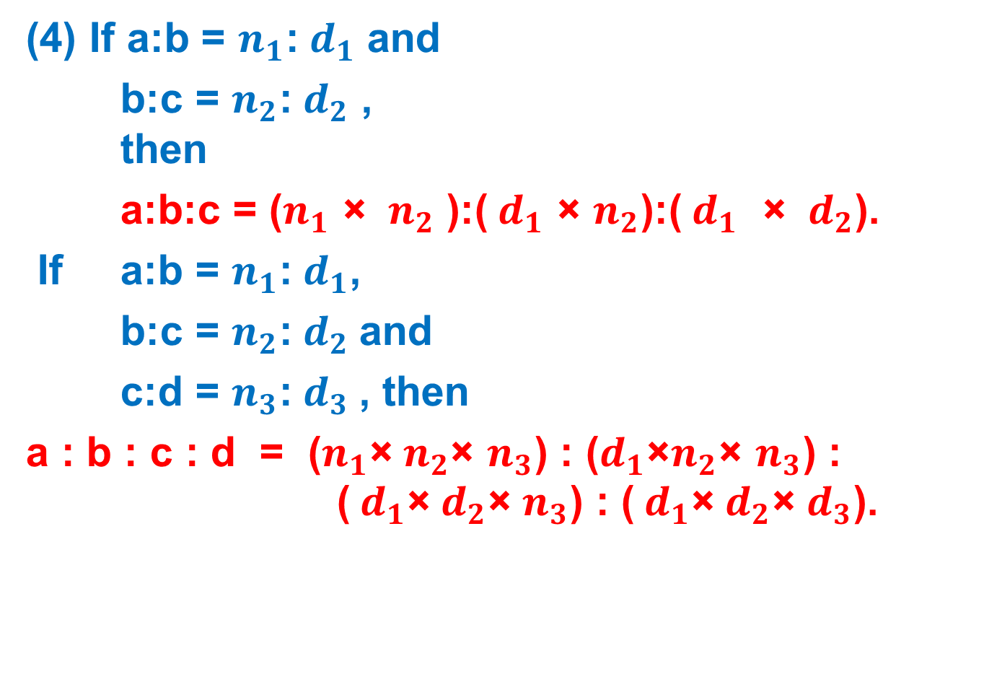
short-cut methods
(4) If a:b = $n_{1}$:${ d}_{1}$ and
b:c = $n_{2}$:${ d}_{2}$ , then
a:b:c = ($n_{1}$ × ${ n}_{2}$ ):(${ d}_{1}$ × $n_{2}$):(${ d}_{1}$ × ${ d}_{2}$).
If a:b = $n_{1}$:${ d}_{1}$,
b:c = $n_{2}$:${ d}_{2}$and
c:d = $n_{3}$:${ d}_{3}$, then
a : b : c : d = ($n_{1}$×${ n}_{2}$× $n_{3}$) : ($d_{1}$×$n_{2}$× $n_{3}$) : (${ d}_{1}$×${ d}_{2}$× $n_{3}$) : (${ d}_{1}$×${ d}_{2}$× $d_{3}$).

Slide 15
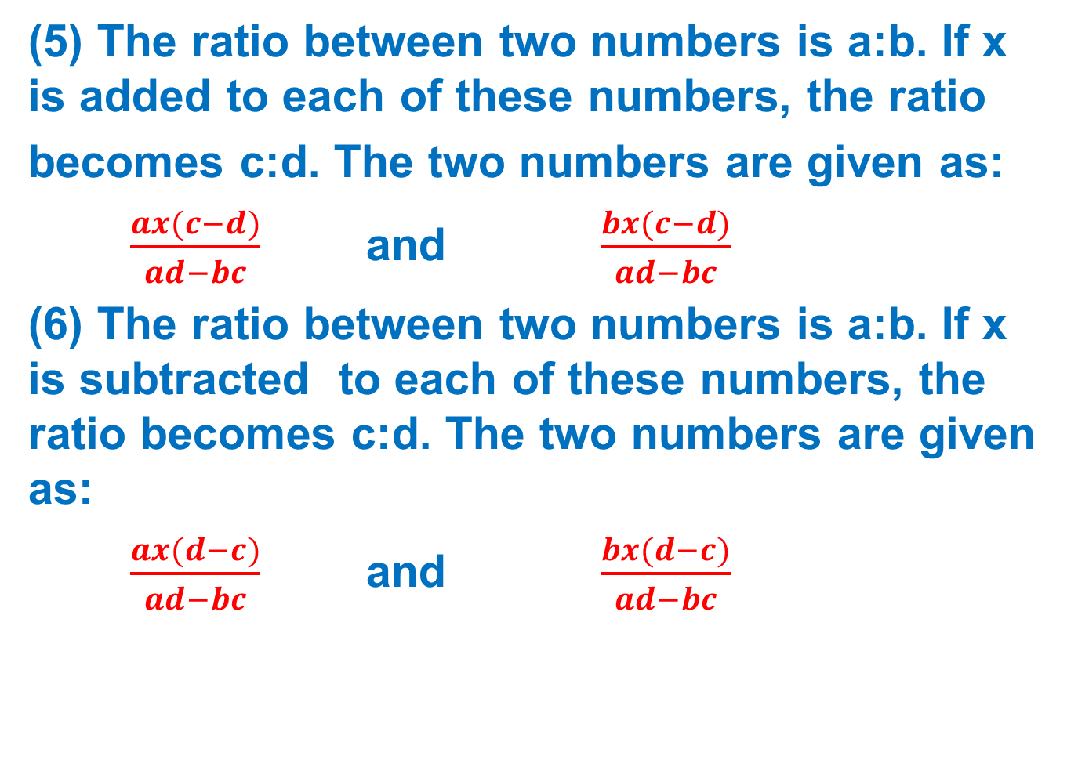
short-cut methods
(5) The ratio between two numbers is a:b. If x is added to each of these numbers, the ratio
becomes c:d. The two numbers are given as:
$\frac{ax(c−d)}{ad−bc}$ and $\frac{bx(c−d)}{ad−bc}$
(6) The ratio between two numbers is a:b. If x is subtracted to each of these numbers, the ratio becomes c:d. The two numbers are given as:
$\frac{ax(d−c)}{ad−bc}$ and $\frac{bx(d−c)}{ad−bc}$

Slide 16
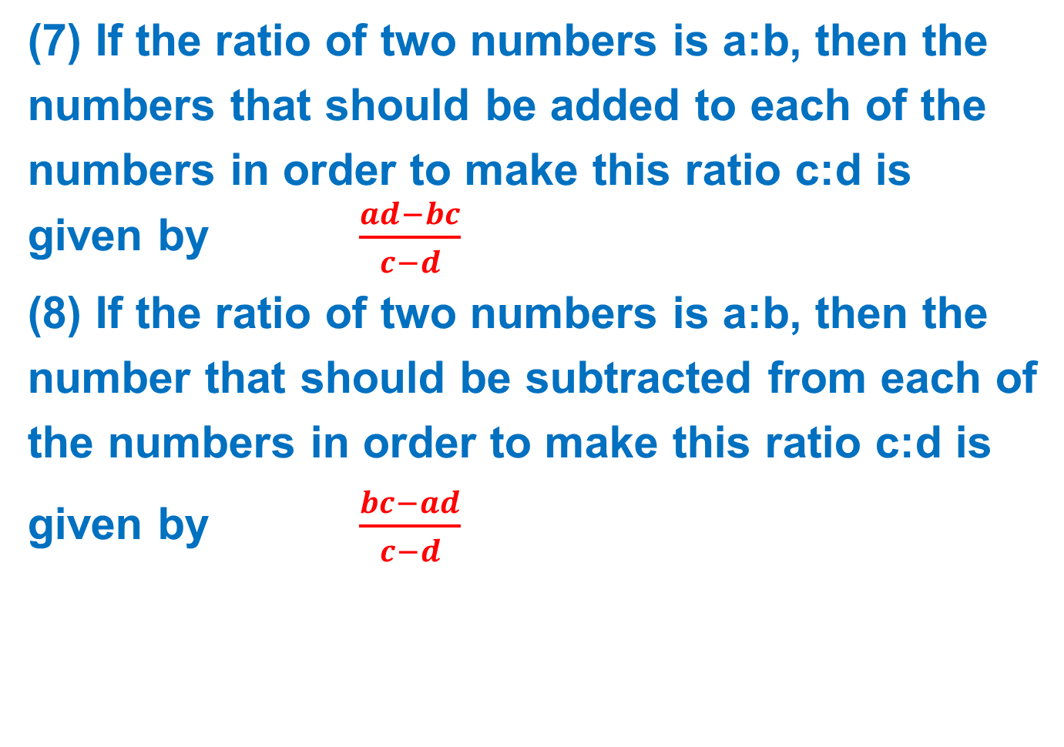
short-cut methods
(7) If the ratio of two numbers is a:b, then the
numbers that should be added to each of the
numbers in order to make this ratio c:d is given by $\frac{ad−bc}{c−d}$
(8) If the ratio of two numbers is a:b, then the
number that should be subtracted from each of
the numbers in order to make this ratio c:d is
given by $\frac{bc−ad}{c−d}$

Slide 17
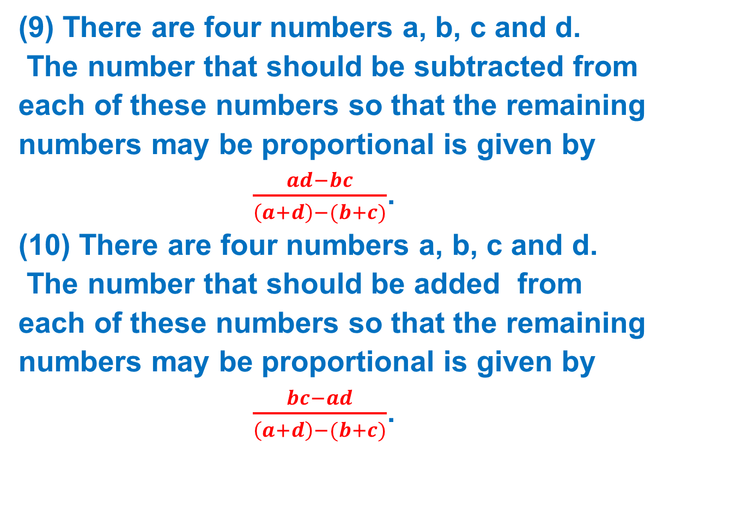
short-cut methods
(9) There are four numbers a, b, c and d.
The number that should be subtracted from
each of these numbers so that the remaining
numbers may be proportional is given by
$\frac{ad−bc}{\left(a+d\right)−(b+c)}$.
(10) There are four numbers a, b, c and d.
The number that should be added from
each of these numbers so that the remaining
numbers may be proportional is given by
$\frac{bc−ad}{\left(a+d\right)−(b+c)}$.

Slide 18
EXAMPLE PROBLEMS
(1) Find a fourth proportional to the
numbers 2, 5, 4.
6
8
10
12

Slide 19

solution: option-c
Let x be the fourth proportional,
then
2 : 5 :: 4 : $x$
or
$\frac{2}{5}=\frac{4}{x}$.
∴ $x$ = $\frac{5 \text{×} 4}{2}$
$x$= 10.

Slide 20
2.Find the mean proportional between 48 and 12.
14
24
34
44

Slide 21
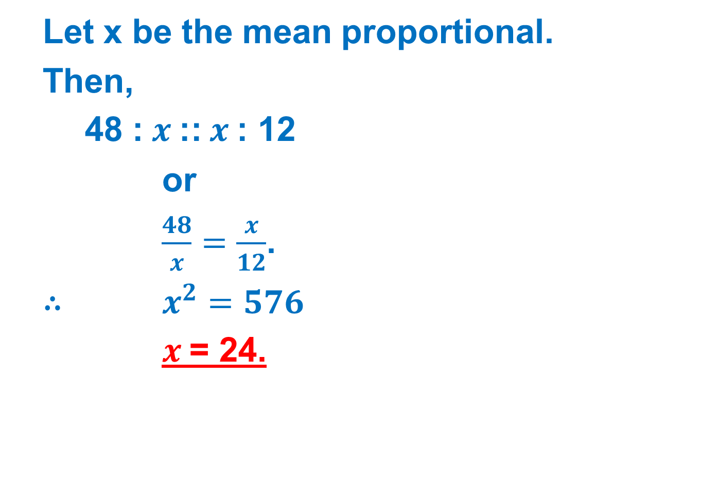
solution: option-b
Let x be the mean proportional.
Then,
48 : $x$:: $x$: 12
or
$\frac{48}{x}=\frac{x}{12}$.
∴ $x^{2}=576$
$x$= 24.

Slide 22
3.Two numbers are in the ratio of 4:5 and the sum of these numbers is 27. Find the two numbers.
12, 15
9, 18
18, 9
15, 12

Slide 23
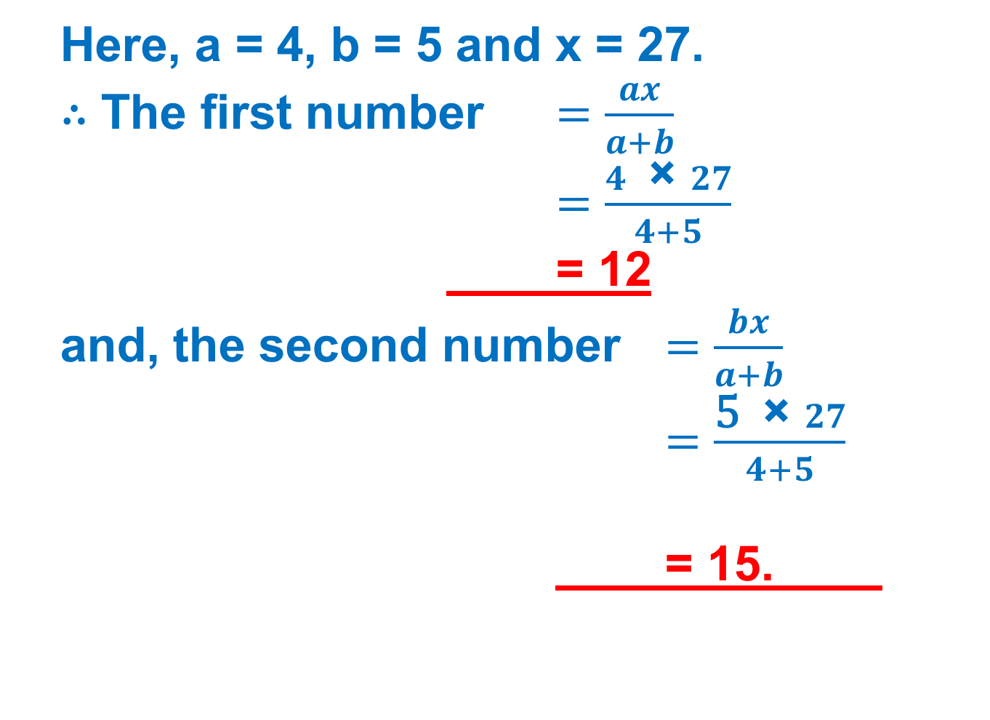
solution: option-a
Here, a = 4, b = 5 and x = 27.
∴ The first number $=\frac{ax}{a+b}$
$=\frac{4 \text{×} 27}{4+5}$
= 12
and, the second number $=\frac{bx}{a+b}$
$=\frac{\text{5} \text{×} 27}{4+5}$
= 15.

Slide 24
4.Three numbers are in the ratio of 3:4:8 and the sum of these numbers is 975. Find the three numbers.
195, 260, 520
205, 270, 530
200, 265, 525
None of these.

Slide 25
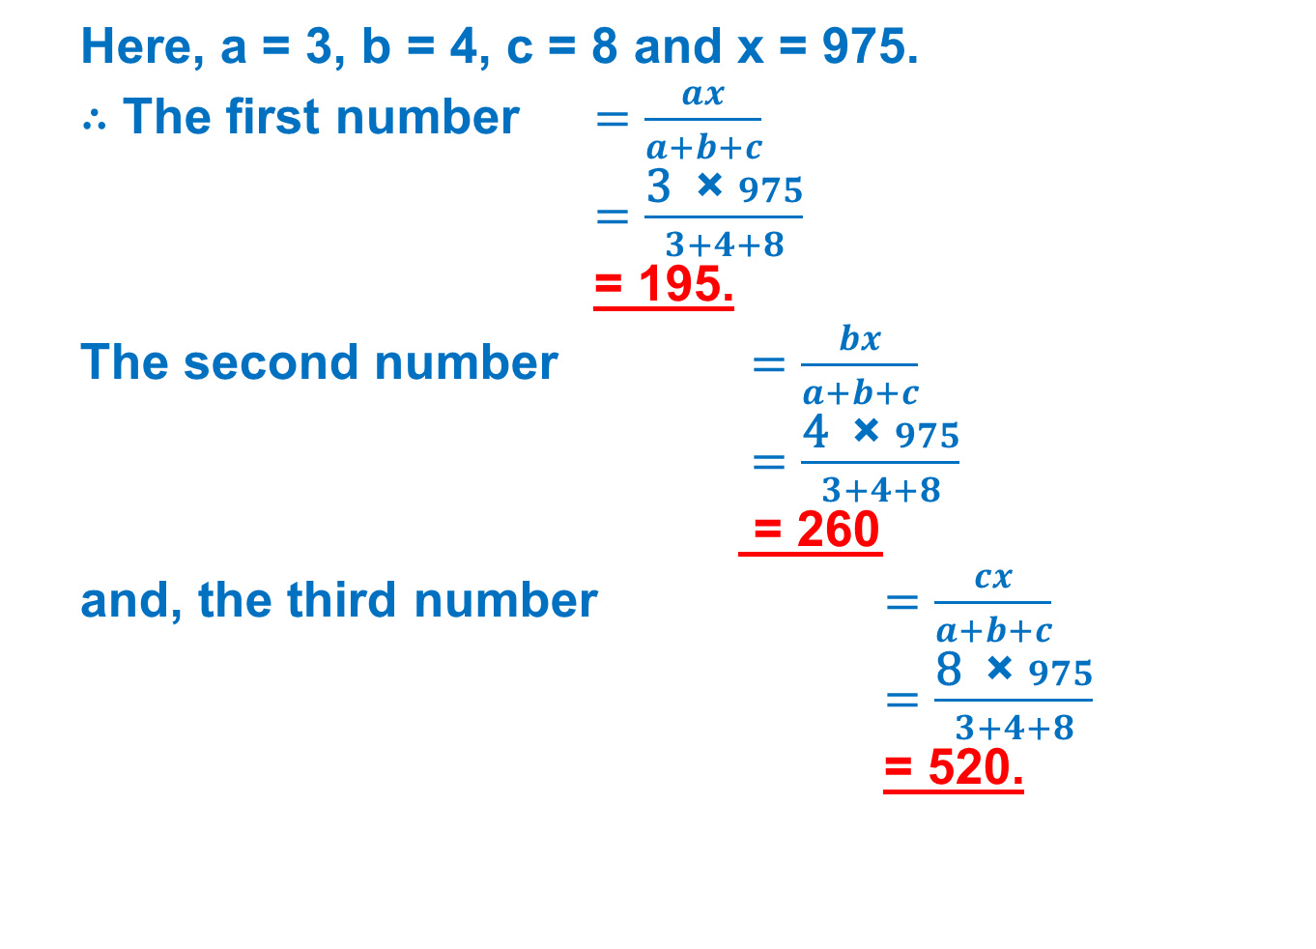
solution: option-a
Here, a = 3, b = 4, c = 8 and x = 975.
∴ The first number $=\frac{ax}{a+b+c}$
$=\frac{\text{3} \text{×} 975}{3+4+8}$
= 195.
The second number $=\frac{bx}{a+b+c}$
$=\frac{\text{4} \text{×} 975}{3+4+8}$
= 260
and, the third number $=\frac{cx}{a+b+c}$
$=\frac{\text{8} \text{×} 975}{3+4+8}$
= 520.

Slide 26
5. Two numbers are in the ratio of 4:5. If the difference between these numbers is 24, then find the numbers.
116, 140
100, 124
96, 120
None of these.

Slide 27

solution: option-c
Here, a = 4, b = 5 and x = 24.
∴ The first number $=\frac{ax}{b−a}$
$=\frac{4 \text{×} 24}{5−4}$
= 96
and, the second number $=\frac{bx}{b−a}$
$=\frac{\text{5} \text{×} 24}{5−4}$
= 120.

Slide 28
6. If A:B = 3:4 and B:C = 8:9, find A:B:C.
4 : 6 : 8
6 : 8 : 9
5 : 6 : 9
None of these.

Slide 29
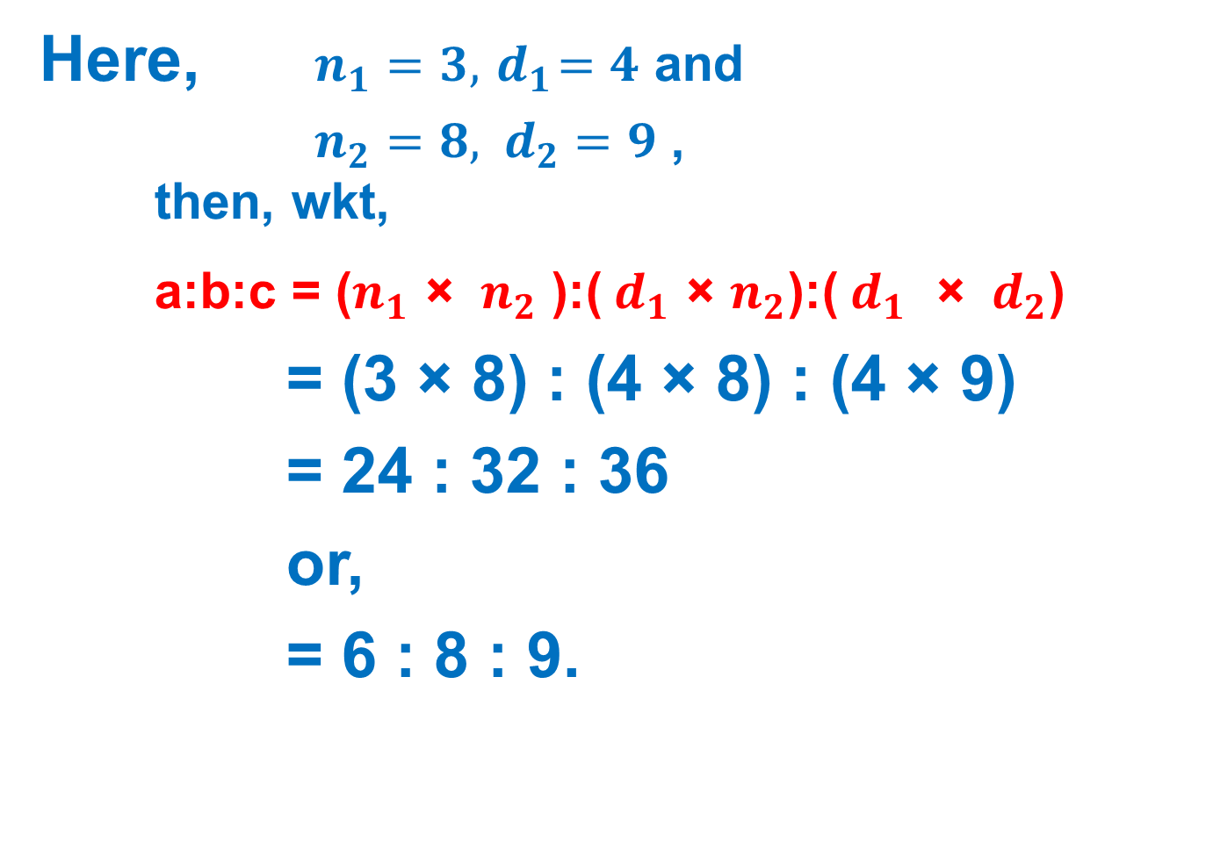
solution: option-b
Here, $n_{1}=3,{ d}_{1}=4$ and
$n_{2}=8, { d}_{2}=9$ , then, wkt,
a:b:c = ($n_{1}$ × ${ n}_{2}$ ):(${ d}_{1}$ × $n_{2}$):(${ d}_{1}$ × ${ d}_{2}$)
= (3 × 8) : (4 × 8) : (4 × 9)
= 24 : 32 : 36
or,
= 6 : 8 : 9.

Slide 30
7. If A:B = 2:3, B:C = 4:5 and C:D = 6:7, find A:D.
16 : 35
24 : 35
24 : 30
16 : 30

Slide 31
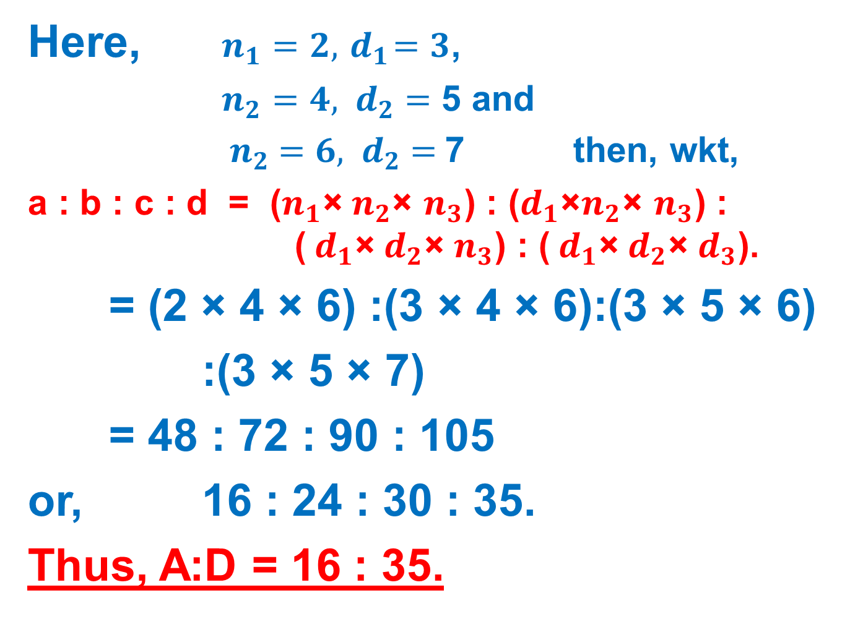
solution: option-a
Here, $n_{1}=2,{ d}_{1}=3$,
$n_{2}=4, { d}_{2}=$ 5 and
${ n}_{2} =6, { d}_{2}=$7 then, wkt,
a : b : c : d = ($n_{1}$×${ n}_{2}$× $n_{3}$) : ($d_{1}$×$n_{2}$× $n_{3}$) : (${ d}_{1}$×${ d}_{2}$× $n_{3}$) : (${ d}_{1}$×${ d}_{2}$× $d_{3}$).
= (2 × 4 × 6) :(3 × 4 × 6):(3 × 5 × 6)
:(3 × 5 × 7)
= 48 : 72 : 90 : 105
or, 16 : 24 : 30 : 35.
Thus, A:D = 16 : 35.

Slide 32
EXERCISE PROBLEMS
(1) Find the value of x in the following proportion:
27 : 72 :: x : 8
5
7
3
None of these.

Slide 33
2.Find a fourth proportional to the numbers 60, 48, 30.
36
24
48
None of these.

Slide 34
3. Find a third proportional to the numbers 4, 42.
441
541
641
None of these

Slide 35
4. If 18 : x = x : 8, then x is equal to:
12
16
18
None of these

Slide 36
5. The mean proportional between 64 and 81 is:
48
68
72
None of these

Slide 37
6. The ratio of two numbers is 3:4 and their sum is 420. The greater of the two numbers is:
360
240
180
None of these

Slide 38
7. In a ratio 11:14, if the antecedent is 55, the consequent is:
70
90
60
None of these

Slide 39
THANK YOU

